Slide 1




Swiggy
Analysis
Presented By: R.Sathish Kumar
Batch Code : MBT11

Slide 2



Overview
Introduction
Tasks

Slide 3


About Company
Swiggy is an Indian online food ordering and delivery company. Founded in 2014, Swiggy is headquartered in Bangalore and operates in more than 580 Indian cities, as of July 2023.[4] Besides food delivery, the platform also provides quick commerce services under the name Swiggy Instamart, and same-day package deliveries with Swiggy Genie.

Slide 4

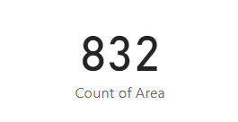
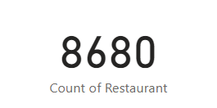



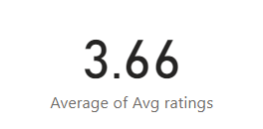
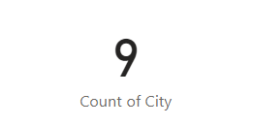


Total Area
Total Restaurants
Average Rating
Total City

Slide 5

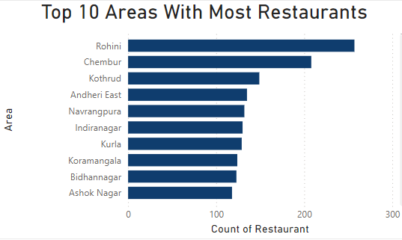
Task 1 : Top 10 Areas With Most Restaurants
Top 10 Areas With Most Restaurants :
Rohini – 257 Restaurants
Chembur – 208 Restaurants
Kothrud – 149 Restaurants
Andheri East – 135 Restaurants
Navrangpura – 132 Restaurants
Indiranagar – 130 Restaurants
Kurla – 129 Restaurants
Koramangala – 124 Restaurants
Bidhannagar – 123 Restaurants
Ashok Nagar – 118 Restaurants

Slide 6
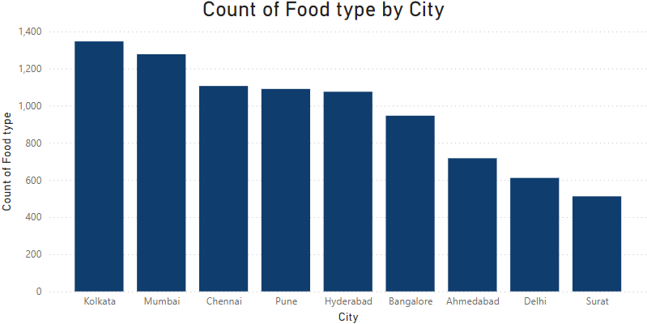
Task 2 : Most Popular Food Types Served by Swiggy Restaurants in Each City

Slide 7
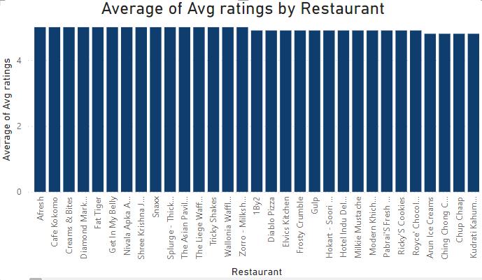
Task 3 : Top rated Swiggy Restaurants .
Average Rating Above 4.5 Rating : 632 Restaurants
5 Rating : 18 Restaurants
4.90 Rating : 15 Restaurants
4.80 Rating : 28 Restaurants
4.70 Rating : 90 Restaurants
4.60 Rating : 157 Restaurants
4.50 Rating : 324 Restaurants

Slide 8
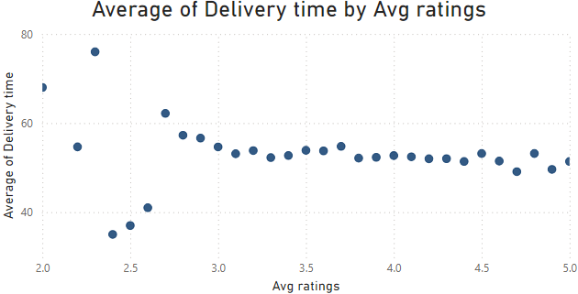
Task 4 : Correlation of Factors Affecting Average Rating
Relationship between Delivery time and Ratings :
Relationship between Delivery time and Ratings
Delivery time increase the rating will be decrease

Slide 9
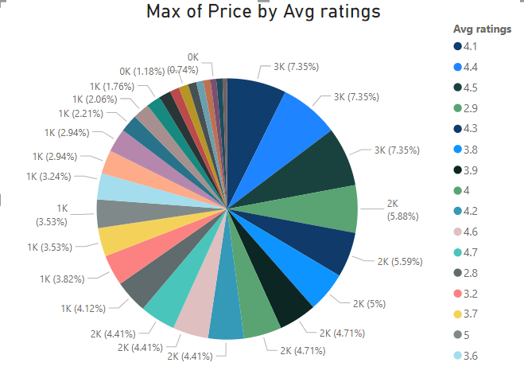
Relationship between price and ratings :
Relationship between price and ratings
Price doesn't affecting rating .
Maximum price range : INR 2500 & Rating 4.1
Minimum Price range : INR 200 & Rating 2.2

Slide 10
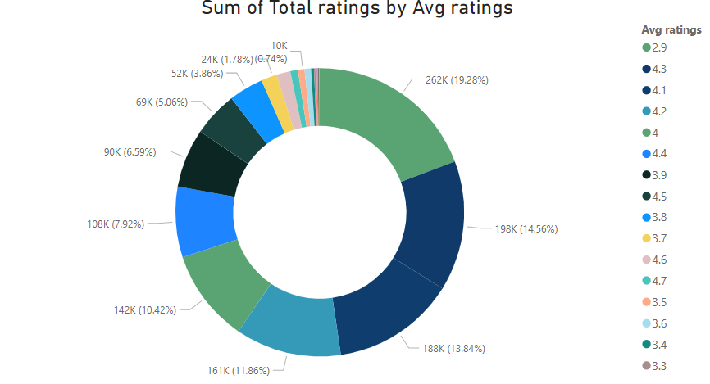
Relationship between total rating and ratings :
Relationship between total rating and ratings :
19.28% total rating has given 2.9
14.56% total rating has given 4.3
13.84% total rating has given 4.1

Slide 11
Task 5 : Correlation Between Restaurants Prices and Average Rating
Relationship between price and ratings
Price doesn't affecting rating .
Maximum price range : INR 2500 & Rating 4.1
Minimum Price range : INR 200 & Rating 2.2

Slide 12
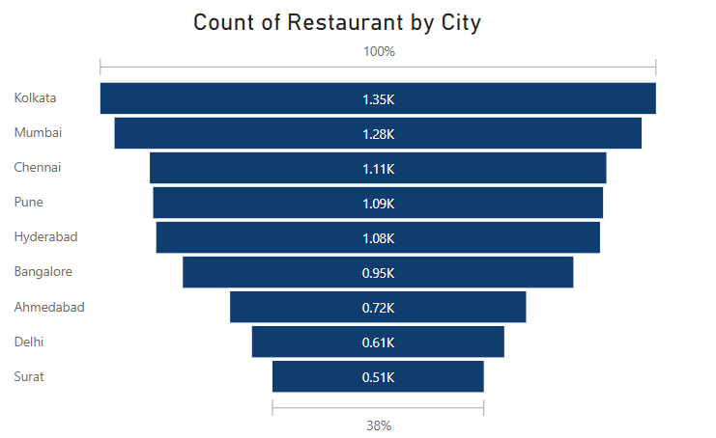
Task 6 : City-Wise Restaurants Count

Slide 13
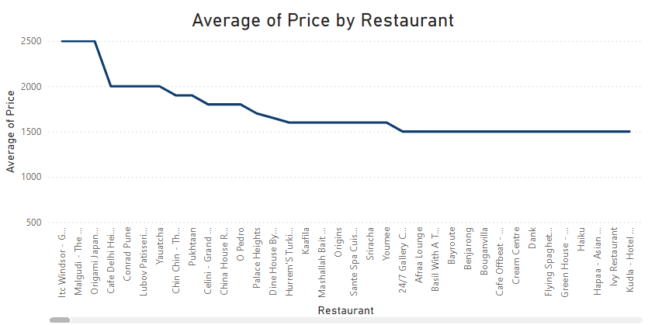
Task 7 : Price Analysis

Slide 14
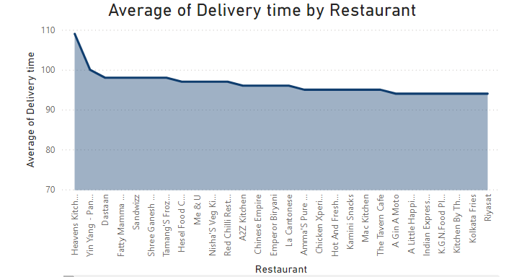
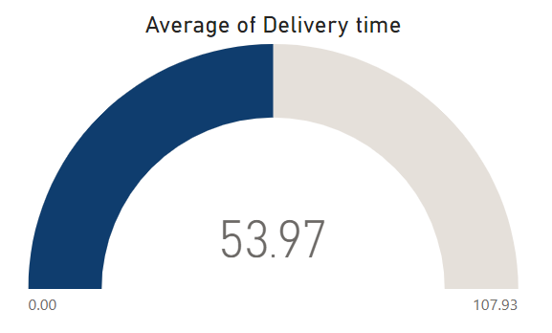
Task 8 : Delivery Time Analysis

Slide 15
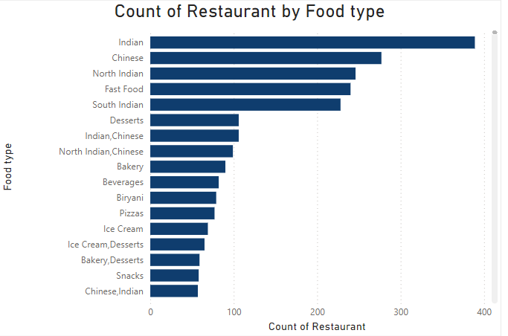
Task 9 : Cuisine Analysis

Slide 16
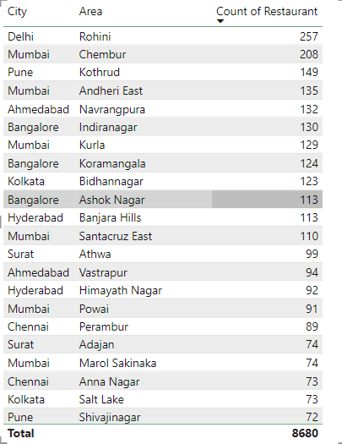
Task 10 : Area-Wise Restaurants

Slide 17
Task 11 : Correlation Analysis

Slide 18

Task 14 : Business Recommendations
Optimize Delivery Time: Since there is a clear negative correlation between delivery time and customer ratings, Swiggy should focus on reducing delivery times in key areas. This could involve increasing the number of delivery personnel during peak hours or optimizing routes using AI-driven solutions to minimize delays.
Expand in Top Areas: Areas like Rohini, Chembur, and Kothrud have a high number of restaurants. Swiggy should consider boosting its marketing efforts in these zones while encouraging more restaurant partnerships to capitalize on existing demand and competition.
Price Insights: Although price doesn’t significantly affect ratings, Swiggy could use this insight to experiment with tiered pricing models, such as premium services with faster delivery times, to cater to different segments without worrying about a negative impact on customer satisfaction.
Focus on High-Rating Restaurants: Out of 632 highly rated restaurants (with ratings above 4.5), only a small percentage achieve perfect scores. Swiggy could leverage these high-rated restaurants in promotional campaigns to attract more users by showcasing top-tier food experiences, thus driving trust and customer retention.

Slide 19




+91 7397413250
Sathishkumaravi29@gmail.com
Thank You
Presented By: R.Sathish Kumar
Batch Code : MBT11

